Slide 1
EENG-4640 Midterm Presentation A.R.G.O.S System
Active Robot Guidance with Obstacle Sensing System
Team 1
Sebastian Oviedo, Anish Goyal, Elizabeth McGlone, Ariana Story

Slide 2
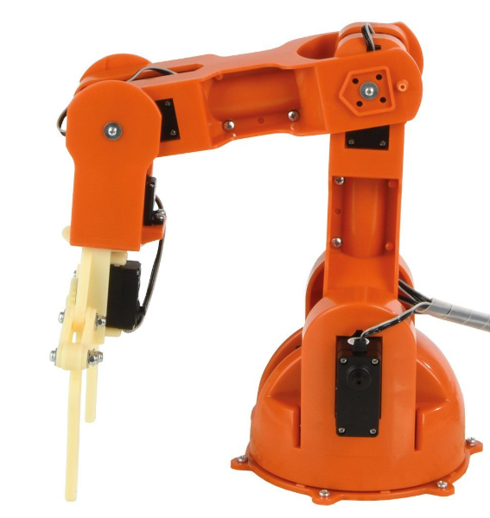
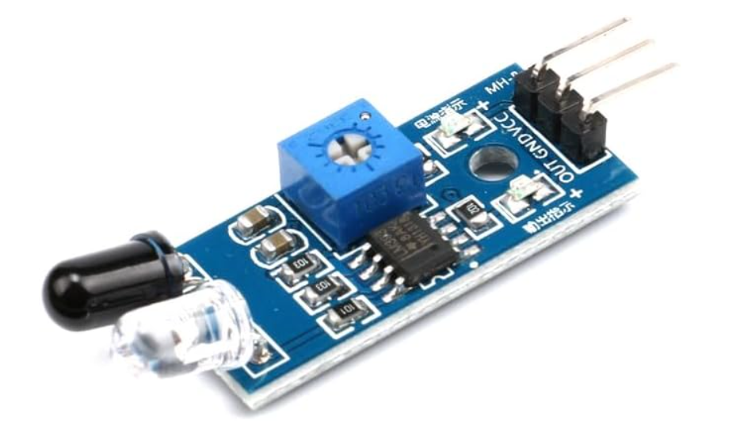
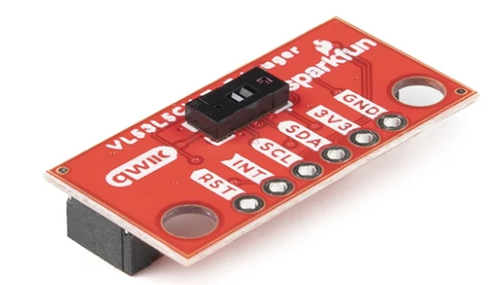
Project Introduction
Obstacle-Aware Robotic Arm:
Prevent collisions before contact
Braccio 6-DOF servo arm
ToF + IR sensors for two-layer safety
Real-time motion adjustment
IR Sensor
TOF Sensor
Notes:
Elizabeth:
Our project focuses on developing an obstacle-aware robotic arm designed to prevent collisions before contact occurs.
Traditional robotic systems either operate inside:
physical cages
or rely on emergency stops after something goes wrong.
Instead of reacting after contact, our system detects obstacles early and adjusts motion in real time.
We are using a Braccio 5-degree-of-freedom servo robotic arm as our hardware platform.
To improve safety, we integrated both Time-of-Flight and Infrared sensors.
These sensors create a two-layer detection system that monitors the workspace continuously.
If an object enters the workspace, the arm can automatically slow down and reroute to avoid obstacles, creating proactive safety.

Slide 3
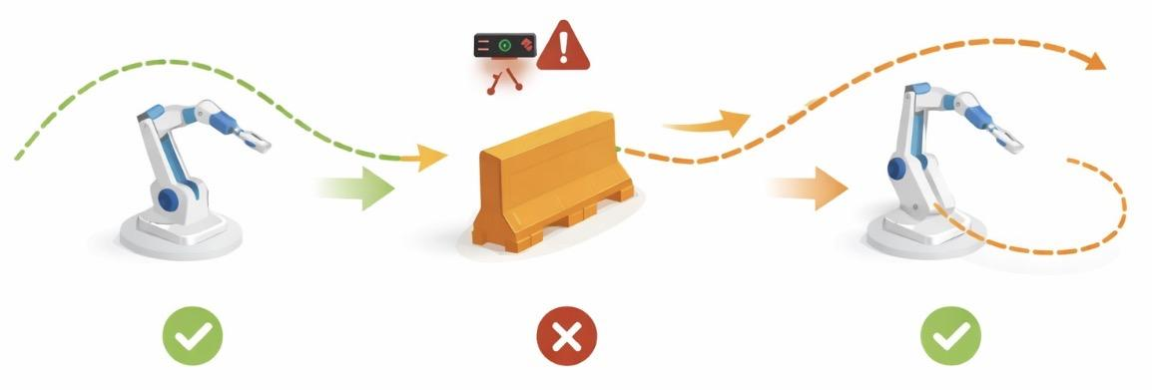
Project Introduction
What the system does:
Arm follows planned path
Sensors monitor workspace
Obstacle detected → trajectory adjusted in real time
Notes:
Elizabeth: “
At a high level, the robotic arm follows a planned trajectory generated using inverse kinematics.
While it operates, the Time-of-Flight and Infrared sensors continuously monitor the workspace and feed real-time distance data to the controller.
If an obstacle is detected within a critical region, the system does not simply stop.
Instead, it recalculates a safe trajectory and adjusts the joint motion to reroute around the obstacle.
Only if a safe path cannot be determined does the arm enter a controlled stop state.
This allows the system to maintain productivity while intelligently adapting to changes in its environment.

Slide 4
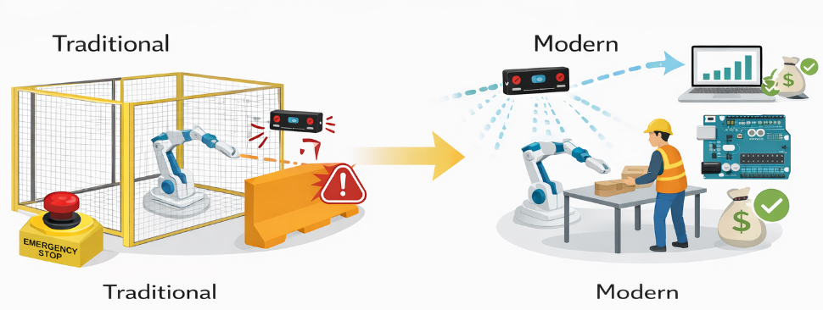
Motivation
Industrial robots often rely on cages or E-stops
Stops reduce productivity
Human–robot workspaces are increasing
Need safer, smarter interaction
Low-cost platform for testing safety ideas
Notes:
Elizabeth:
Our motivation comes from the way industrial robots are traditionally deployed.
Most industrial robots operate inside cages or rely heavily on emergency stop systems.
While these approaches improve safety, they reduce flexibility and productivity.
At the same time, human–robot shared workspaces are becoming more common, especially in collaborative robotics.
This creates a need for safer and smarter interaction methods.
Our goal was to build a low-cost platform that allows us to test and demonstrate proactive safety concepts — essentially creating a scaled-down model of how intelligent industrial safety systems could work.”

Slide 5
Project Background
ToF
Provides early obstacle detection in 60° FOV
High accuracy and less affected by lighting or surface color
Long-range detection (up to ≈4 m)
IR
Provides 360° close-range coverage
Low cost and easy to mount around arm links
Short-range detection (≈4-80 cm)
Notes:
Ariana: For obstacle detection, we use two different sensor types to provide multi-layer protection
1. The Time of Flight (TOF) sensors - allow the system to detect obstacles much sooner. They are highly accurate and are less affected by poor lighting conditions or the color of the object's surface. They can detect objects up to 4 meters away, giving the robot time to move around the object rather than stopping abruptly. 2. The infrared sensors provide 360 degree close-range coverage. They are also cheap, lightweight, and easy to mount on individual arm links. These sensors are effective at ranges from 4 - 80 centimeters. Using these two sensors together allows for safe operation regardless of the type of interruption.

Slide 6
Project Background
Obstacle Avoidance Strategies:
Threshold-based stopping with hysteresis
Artificial Potential Fields (APF)
Trajectory replanning
Real-time collision avoidance
Notes:
Ariana: Although the object avoidance feature has not been implemented yet, here are some of the strategies that we are considering:
Threshold-based stopping is a simple reactive method which stops the movement of the arm if an object breaches the threshold. This is common in safety-focused designs, as stated by ISO 10 2 18 dash 2.
The Artificial potential fields models obstacles as repulsive forces and goals as attractive forces. This allows for smoother avoidance behavior.
Various trajectory replanning approaches, such as sampling-based, are also commonly used in robotics.

Slide 7
Project Background
Robotics System Architecture & Control:
Distributed sensing and control
Microcontroller for fast actuation
Higher-level planning on PC
Closed-loop feedback improves safety
Notes:
Ariana:
Many robotic systems separate sensing and actuation tasks to improve reliability and speed. Embedded control research demonstrate these benefits of high-frequency motor control loops on microcontrollers.
Evaluation studies also emphasize the importance of feedback and fast response time for safety-critical systems.
This layered approach directly influenced our architecture: the microcontroller enables rapid safety measures, while the PC enables advanced decision making.

Slide 8
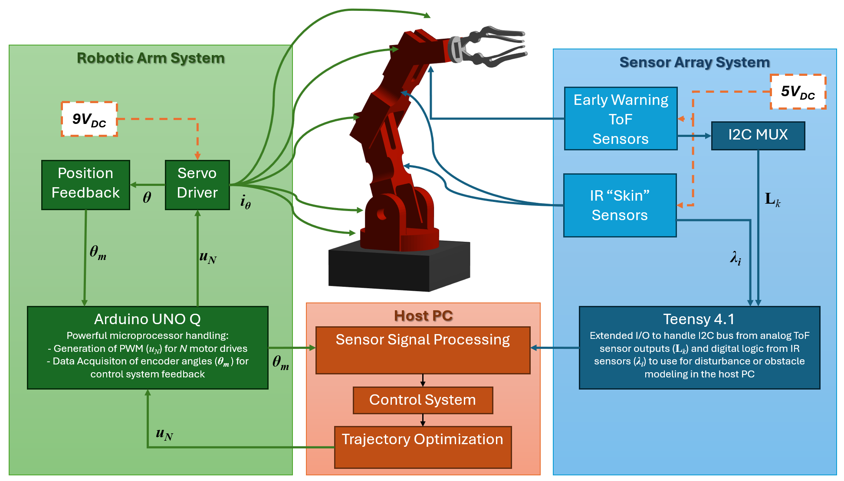
Hardware Block Diagram
Notes:
Sebastian: “This slide shows the overall hardware architecture of our robotic arm system. The system is divided into two major sections: the Robotic Arm System on the left and the Sensor Array System on the right. At the center is the Host PC, which acts as the main processing and decision-making unit.”
Robotic Arm System (Left Side)
“Starting on the left side, this is the robotic arm subsystem.
We are using a 6-degree-of-freedom servo-based robotic arm. Each joint is driven by a servo motor, which provides position control.
To improve feedback and accuracy, we integrate encoders on the joints. These encoders measure the angular position, theta, of each joint. That feedback is sent into the Teensy 4.1 microcontroller.
The Teensy acts as the low-level controller. It handles:
PWM signal generation for the motor drivers,
Data acquisition from the encoders,
And real-time feedback control of joint positions.
The motor drivers receive control signals from the Teensy and supply the required power to the servos.
So essentially: Encoders → Teensy → Motor Drivers → Servos → Mechanical Motion.”
Power System
“In the center of the diagram, we show the 9V DC power supply. This powers the control electronics and motor driver circuitry. Proper power isolation and regulation are important here to reduce noise affecting sensor readings.”
Host PC (Central Intelligence)
“The Host PC is the high-level decision-making unit of the system.
It performs three main functions:
Sensor Signal Processing
Control System Computation
Trajectory Optimization
The PC receives sensor data from the sensor array and encoder feedback from the arm.
Based on obstacle detection and joint position feedback, it dynamically adjusts the trajectory to prevent collisions in real time.”
Sensor Array System (Right Side)
“On the right side is our Sensor Array System, which is responsible for environmental awareness.
We divide sensing into two layers:
First, Early Warning ToF Sensors. These are long-range Time-of-Flight sensors used to detect objects at a distance. They provide an early alert that something is entering the robot’s workspace.
Second, Reactive IR Sensors. These are short-range infrared sensors used for immediate collision avoidance when an object gets very close.”
Arduino Mega + I2C MUX
“The sensors are connected to an Arduino Mega.
We use an I2C multiplexer because multiple ToF sensors share the same I2C address. The multiplexer allows us to sequentially read each sensor independently.
The Arduino collects all sensor data and sends it to the Host PC for processing.
So the data flow on this side is: Sensors → I2C MUX → Arduino Mega → Host PC.”
System-Level Operation
“At a system level, the workflow is:
Sensors detect potential obstacles.
Arduino sends data to the Host PC.
Host PC evaluates risk and computes an updated trajectory.
Control signals are sent to the Teensy.
Teensy generates PWM signals to adjust servo positions.
Encoders provide feedback to close the control loop.
This creates a closed-loop, sensor-fusion-based collision prevention system.”
Design Justification (Optional if time allows)
“We separated responsibilities intentionally:
The Teensy handles real-time motor control because it has high-speed PWM capability.
The Arduino Mega handles multiple sensors due to its larger number of I/O pins.
The Host PC handles trajectory optimization because those calculations are computationally heavier.
This distributed architecture improves stability, modularity, and scalability.”

Slide 9
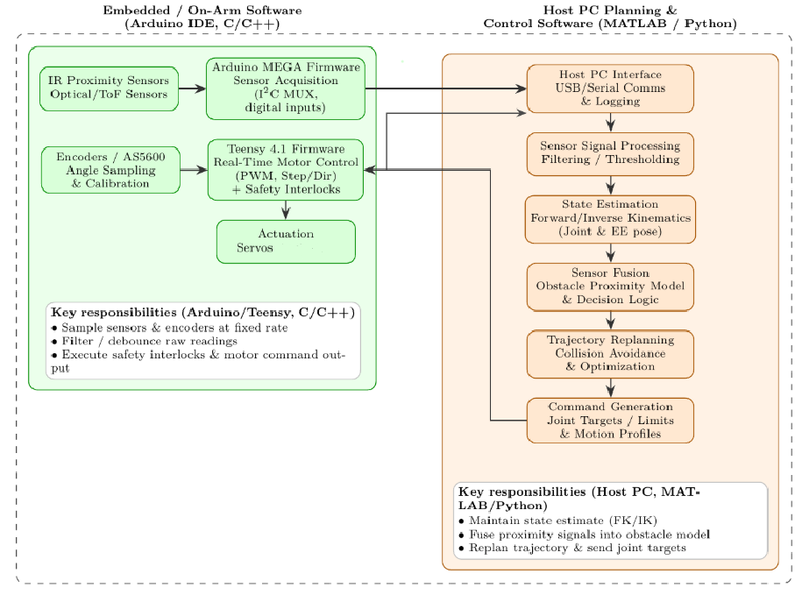
Program Flow Diagram
Examples
Notes:
Anish: “This slide shows how our software is divided between the embedded controllers on the arm and the Host PC.
On the left side is the embedded, on-arm software written in C/C++ using the Arduino IDE.
The Arduino Mega handles sensor acquisition. It reads data from the IR proximity sensors and the Time-of-Flight sensors through the I2C multiplexer.
The Teensy 4.1 handles real-time motor control. It reads encoder data for joint angle sampling and calibration, generates PWM or step signals, and executes safety interlocks before sending commands to the servos.
At this level, the responsibilities are:
Sampling sensors and encoders at a fixed rate,
Filtering or debouncing raw signals,
Executing safety checks and low-level motor commands.
On the right side is the Host PC software, implemented in MATLAB or Python.
The Host PC handles higher-level planning and decision-making. The data flow is:
USB/Serial communication and logging,
Sensor signal processing and filtering,
State estimation using forward and inverse kinematics,
Sensor fusion to build an obstacle proximity model,
Trajectory replanning for collision avoidance,
Command generation for updated joint targets and motion profiles.
The updated joint commands are then sent back to the embedded controllers for execution.
Overall, this separation allows the embedded system to focus on real-time control and safety, while the Host PC handles computationally intensive tasks like kinematics, sensor fusion, and trajectory optimization.”

Slide 10
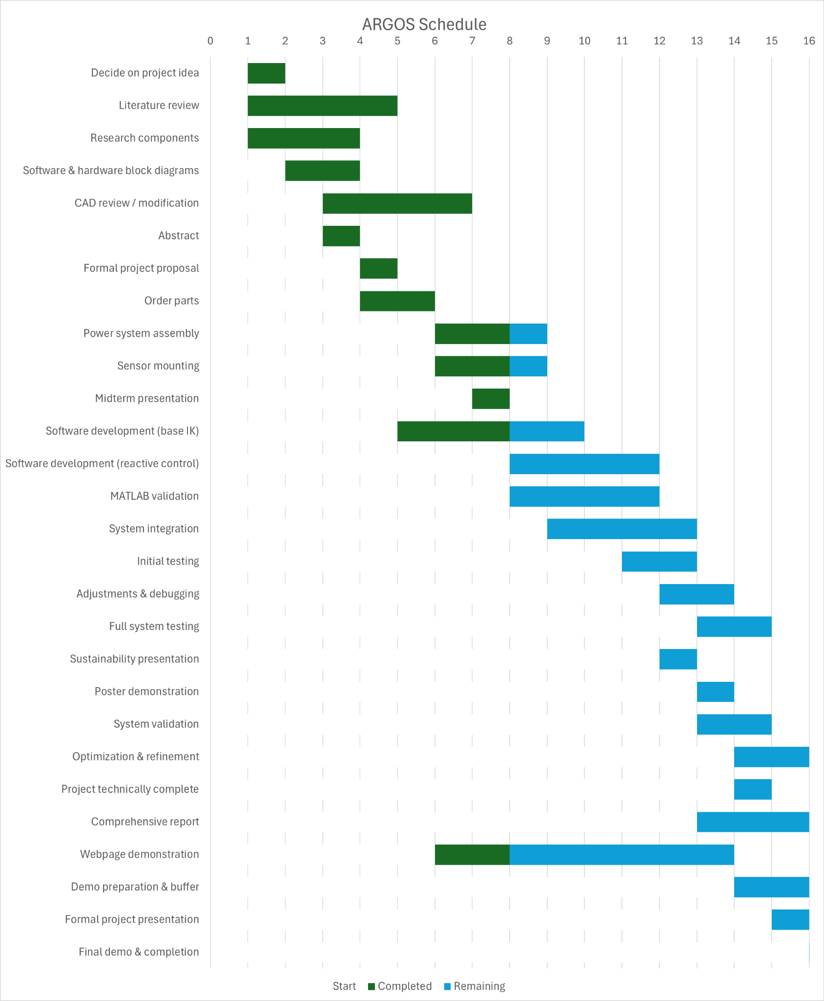
Project Schedule
Notes:
Elizabeth:
What This Slide Shows
This slide demonstrates our full project timeline from Week 1 to Week 16.
Green bars represent work we’ve already completed.
Blue bars represent work that is still remaining.
The schedule is organized into three major phases:
Planning and design
Development
Integration, testing, and final deliverables

Slide 11
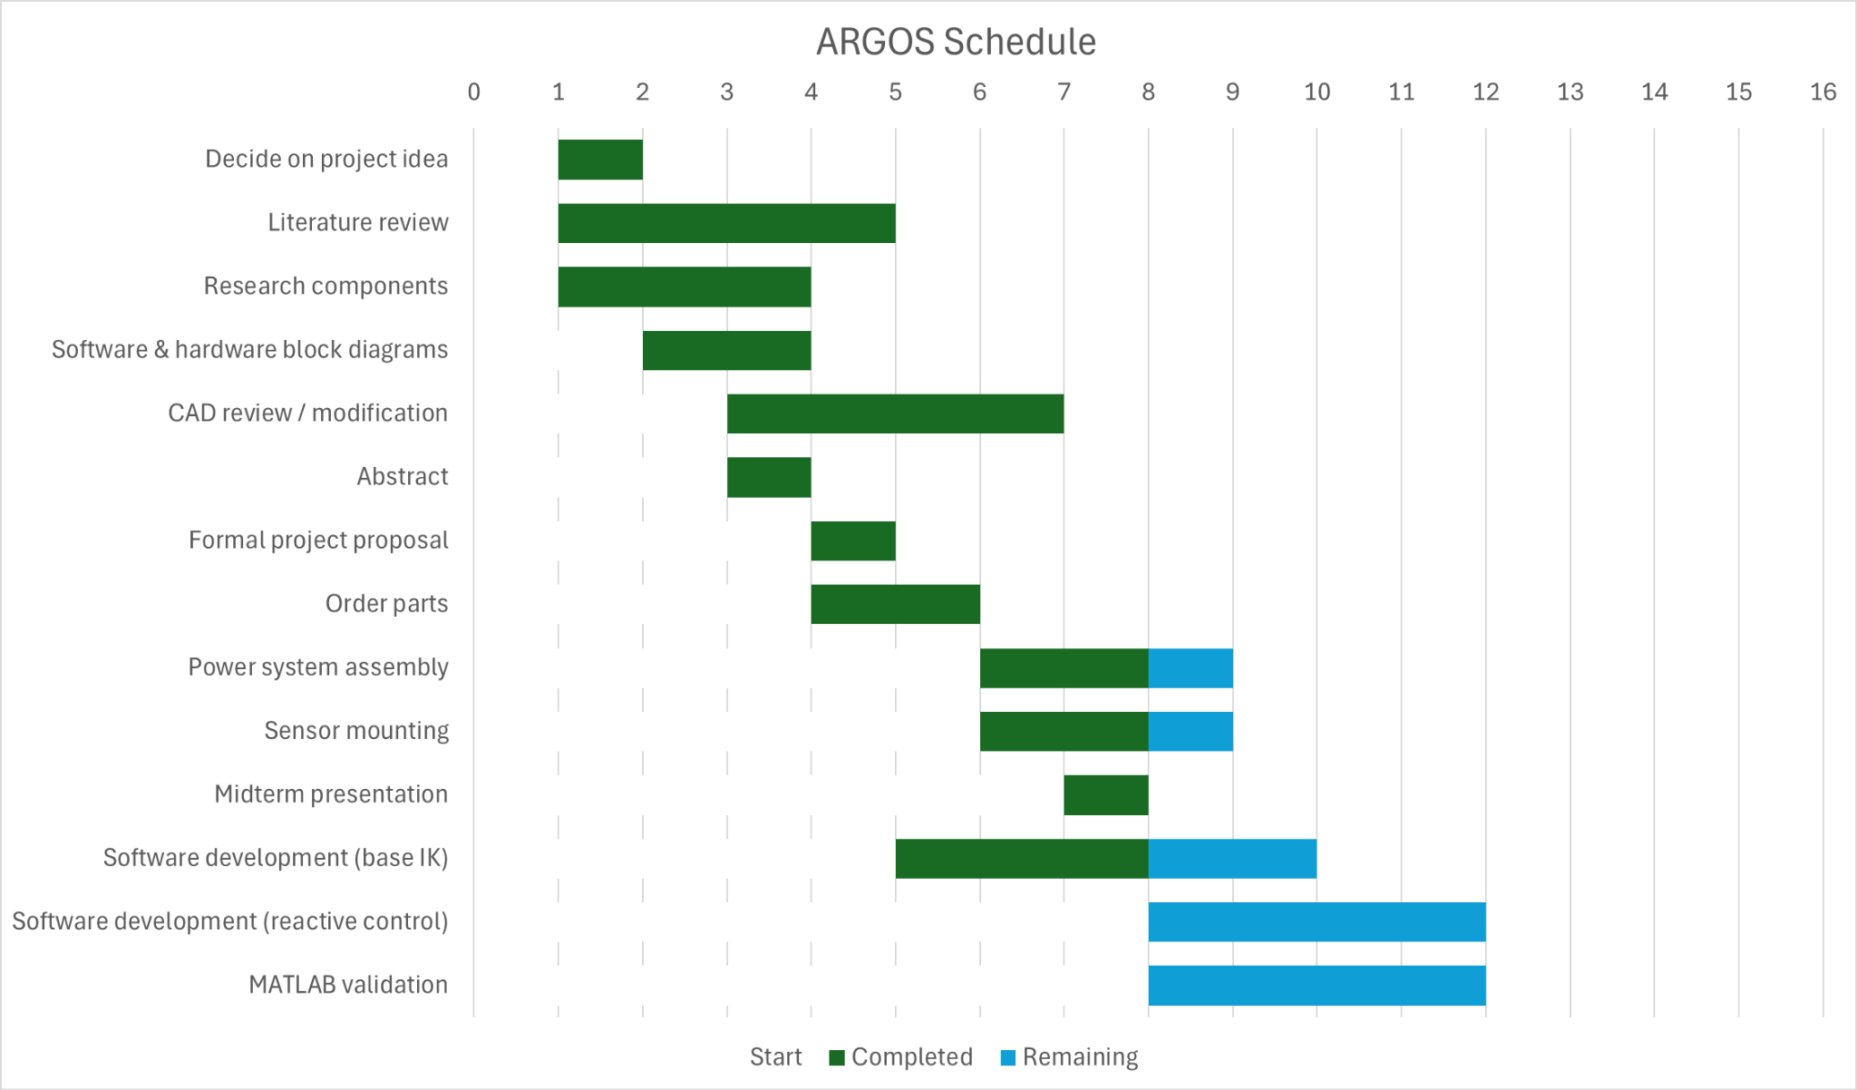
Project Schedule : 0-8 Weeks
Notes:
This slide displays our Early Semester Focus
* In the first half of the semester, our focus was on planning, research, and initial implementation.
* In weeks 1-4,
* We completed literature review, component research, and hardware–software block diagrams.
* We also finalized our CAD modifications and ordered components.
* In weeks 5-8, Once parts arrived,
* we assembled the power system and 3D printed the sensor mounts for the robotic arm.
* In parallel, we began base inverse kinematics development and started reactive control programming.
* By mid-semester, we have a functional arm with sensors mounts and the initial control framework running.

Slide 12
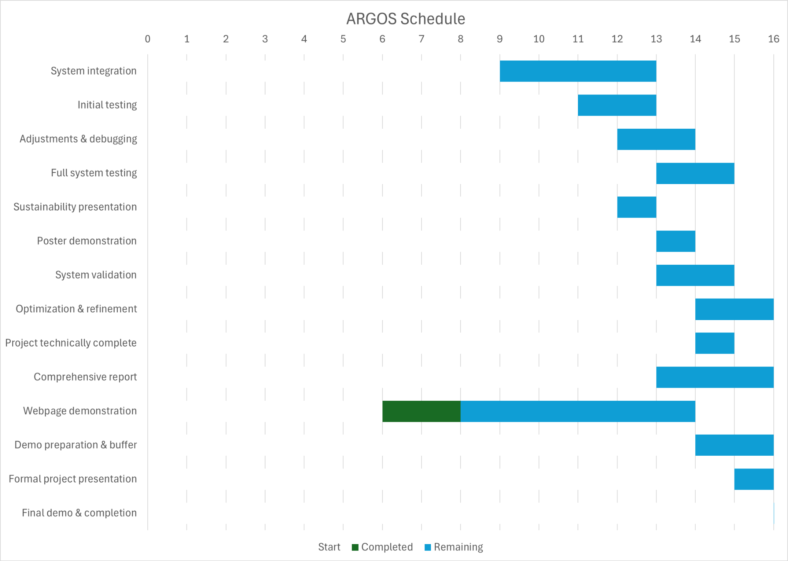
Project Schedule : 9-16 Weeks
Notes:
Elizabeth:
🔹 This slide displays the second Half of the Semester Focus, weeks 9-16
In the second half of the semester, we will shift toward integration, testing, and refinement.
This phase includes full system integration, initial testing, debugging, and optimization.
We plan on validating the control logic through MATLAB simulations and comparing that to physical testing results.
We have also built buffer time before final demonstrations to allow for troubleshooting.
Our goal is to have the system technically complete ahead of the final presentation so that we can focus on stability and demonstration quality.

Slide 13
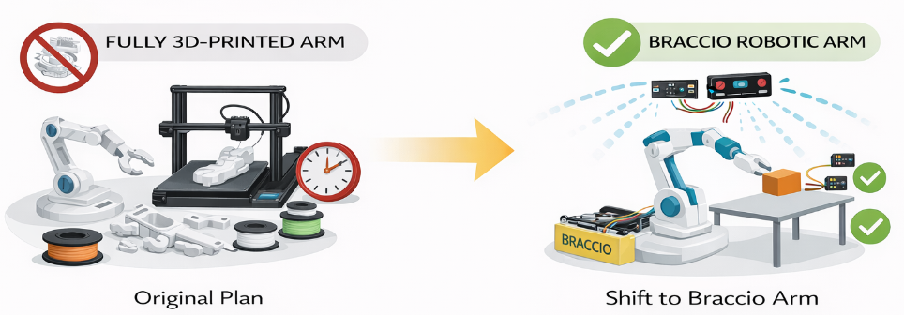
Project Main Challenges
Mechanical & Integration Challenges:
Original plan: fully 3D-print robotic arm
Printing and assembly time constraints
Shift to Braccio arm to manage scope
Mounting and wiring multiple sensors
Preventing sensor interference
Notes:
Elizabeth:
This slide summarizes the main challenges we have faced so far, especially on the mechanical and integration side of the project.
Even though our project is mostly about sensing and control, we still had to solve a lot of “real-world” hardware issues to make everything work together.
“One of our biggest challenges was scope management.
Originally, we planned to fully 3D-print the robotic arm.
However, printing time, assembly complexity, and reliability concerns made that approach unrealistic within one semester.
To stay on schedule, we shifted to using the Braccio robotic arm as our platform, obtained through a third party with some servo replacements needed for proper functioning.
Even with that change, mounting multiple sensors securely and routing wiring cleanly required careful mechanical design.
Another key challenge was preventing interference between sensors while maintaining full workspace coverage.”

Slide 14
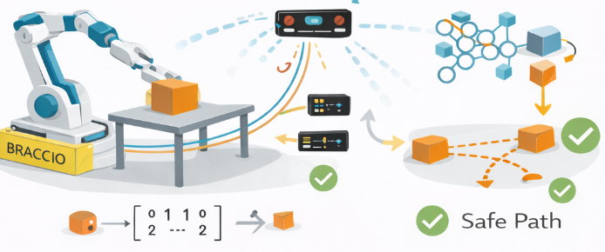
Project Main Challenges
Software & Control Challenges:
Ensuring modeling/simulation compatibility
Implementing inverse kinematics correctly
Managing servo speed and smooth motion
Processing sensor data in real time
Converting detection into safe motion decisions
Notes:
In addition to mechanical challenges, most of the complexity in our project is actually in the software and control system.
“On the software side, implementing inverse kinematics correctly was a major challenge.
The arm must convert position commands into joint angles accurately while remaining stable.
We also needed to ensure compatibility between our MATLAB simulations and the physical hardware.
Managing servo speed for smooth motion was critical, especially when transitioning from normal operation to slow or stop states.
Additionally, sensor data must be processed in real time.
The controller must quickly convert distance measurements into safe motion decisions without causing jitter or instability.
Balancing responsiveness, smooth motion, and safety has been one of the most technically challenging aspects of this project.

Slide 15
Project Goals
Integrate ToF + IR sensors onto Braccio arm
Achieve reliable obstacle detection within defined zones
Implement real-time stop and slow behavior
Demonstrate trajectory adjustment around obstacles
Notes:
Ariana:
Our goals for this project include the following:
Integrating the IR and ToF sensors so the robot can detect obstacles within its working area.
The system must reliably detect obstacles within clearly defined safety zones.
First we will implement reactive behaviors like slowing and stopping.
Then we will move to more advanced object avoidance techniques like Artificial Potential Fields

Slide 16
Project Goals
Validate performance through repeated testing
Measure safety margin and response time
Ensure smooth, stable servo motion
Complete full system by Week 14
Allow 2-week buffer before final demo
Notes:
Ariana:
These goals focus on validation and project management.
We will test the system multiple times to confirm consistency.
Once that’s done, we will measure the response time and minimum safe distance to make sure the safety features are working as intended.
Lastly, we will ensure that the servo motion remains smooth and controlled.
Our timeline sets us on track to finish our technical work by Week 14, leaving two weeks for final preparation and contingency.

Slide 17
Project Implementation Details:
Inverse Kinematics
Talk about any specific design, fabrication, testing implementation details already being solved.
Include pictures of things implemented with proper labels
Notes:
Anish:
*Talk about IK software development, and the mechanics of the system.*

Slide 18
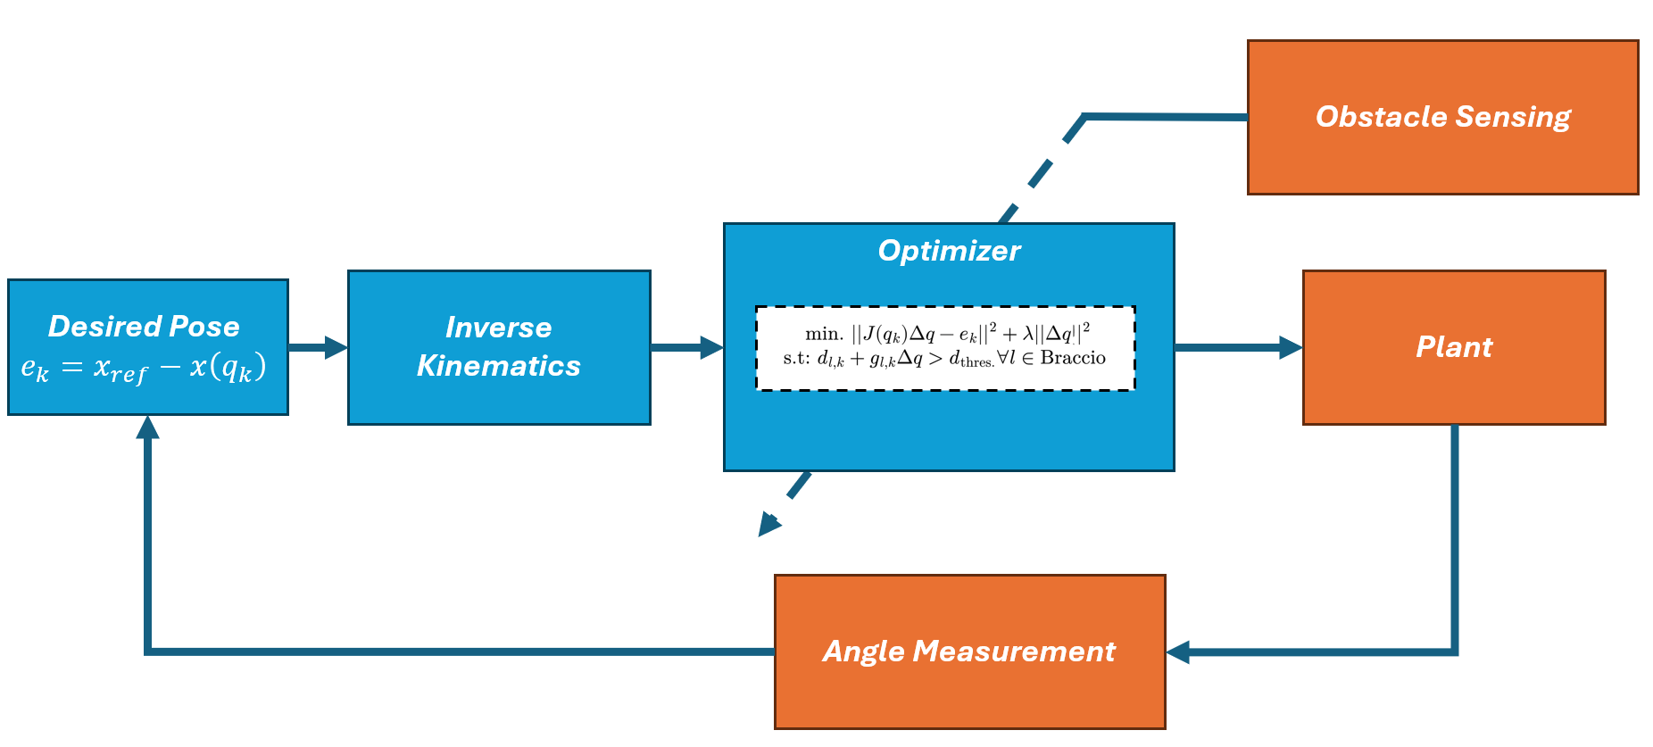
Project Implementation Details
Trajectory Optimization
Using quadratic programming to recalculate an optimal approach to target considering detected obstacle.
Notes:
Sebastian: Trajectory Optim. Math / Sensors

Slide 19
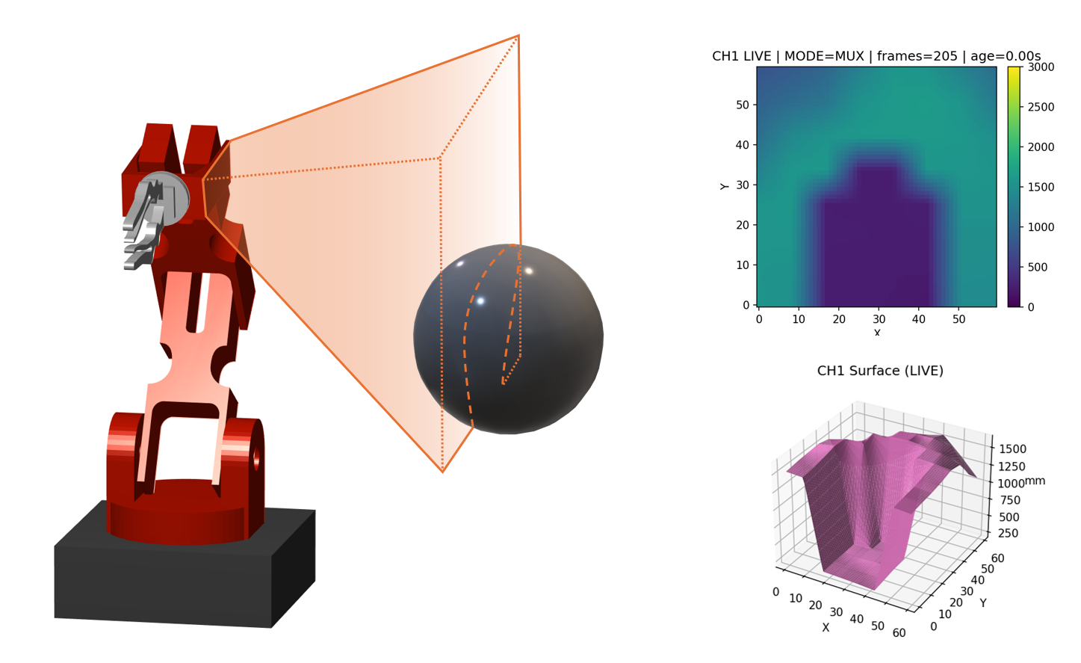
Project Implementation Details
ToF Sensor Deployment
Mounted on end-major-effector of the braccio, used for global optimization.
Notes:
Sebastian: Trajectory Optim. Math / Sensors

Slide 20
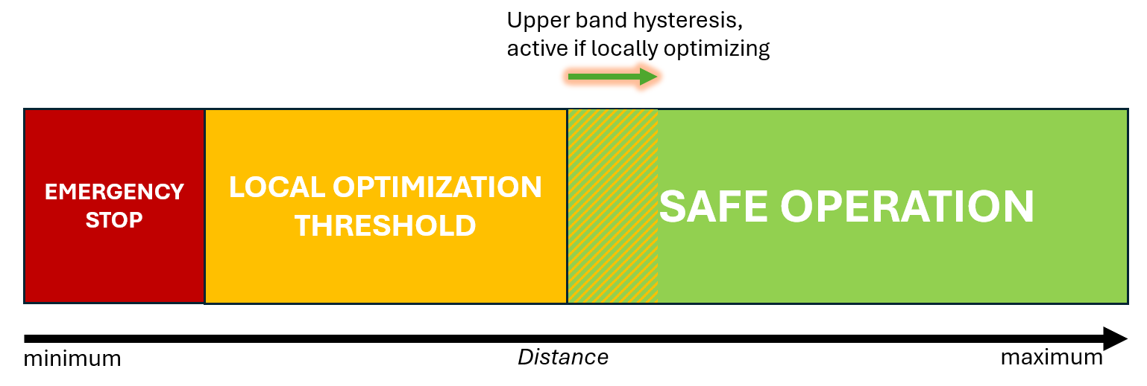
Project Implementation Details
IR “Skin” Deployment
Using hysteresis-based control, protect inner-effectors of arm. Used for local optimization
Notes:
Sebastian: Trajectory Optim. Math / Sensors

Slide 21
Project Initial Results
Present any initial results already obtained up to this point (include pictures, video)
Notes:
Sebastian

Slide 22
Deliverables
What your team expects to deliver as the final products for your project
Include a guide or manual that will be included in the Appendix section of the final report.
Notes:
Anish

Slide 23
Conclusions
Notes:
Anish

Slide 24

Questions?
Notes:
Anish

Slide 25
References
[1] A. A. Al-Hamadani and M. Z. Al-Faiz, “Design and implementation of inverse kinematics algorithm to manipulate 5-DOF humanoid robotic arm,” in Proc. [Conference on Innovation and Intelligence for Informatics, Computing, and Technologies], 2021, pp. 693-697.
[2] J. Tian, M. Gao, and E. Lu, “Dynamic collision avoidance path planning for mobile robot based on multi-sensor data fusion by support vector machine,” in Proc. IEEE Int. Conf. on Mechatronics and Automation (ICMA), Harbin, China, Aug. 2007, pp. 2779-2783.
[3] N. Zhang, Y. Zhang, J. Cheng, and C. Ma, “Inverse kinematics solution for six-DOF serial robots based on BP neural network,” in Proc. [Conference Name], 2022, pp. 1–4.
[4] Adafruit, “IR Sensor Tutorials for Arduino,” [Online]. Available: https://learn.adafruit.com (accessed Jan. 21, 2026).
[5] SparkFun Electronics, “Qwiic ToF Range Finder Hookup Guide,” [Online]. Available: https://learn.sparkfun.com/tutorials/qwiic-tof-range-finder-hookup-guide (accessed Jan. 20, 2026).
[4] International Organization for Standardization, “ISO 10218-2:2025 — Robotics — Safety requirements — Part 2: Industrial robot applications and robot cells,” ISO, 2025. [Online]. Available: https://www.iso.org/standard/73934.html. [Accessed: Mar. 1, 2026].

